Slide 1

AIDEX Assistant
An AI assistant that learns how each person likes to be helped, and measures it
Palden Gurung · S00391340 AIDEX Lab Chatbot Presentation · Australian Catholic University
Notes:
Hi Professor, I'm Palden Gurung. For my project I built the AIDEX Assistant, a chatbot for the AIDEX Lab with one big idea: it learns how each person likes to be helped, and then it checks whether that actually made a difference. In the next few minutes I'll take you from the problem, to what I built, to where it goes next.

Slide 2

Re-introducing yourself to AI, again
A REAL-LIFE EXAMPLE
New chat · Monday
New chat · Wednesday
New chat · Friday
"I'm a second-year IT student. Keep it short and give me an example."
"I'm a second-year IT student. Keep it short and give me an example."
"I'm a second-year IT student. Keep it short and give me an example."
Explain recursion
Help me plan my assignment
What is a REST API?
Typed again · Same 13 words, three times in one week
The AI knows the facts, but forgets how you like to be helped.
Notes:
Let me start with something most of us have done. It's Monday. You open an AI assistant and type, 'I'm a second-year IT student, keep it short and give me an example', and then you ask about recursion. On Wednesday you open a new chat and type the exact same sentence before asking about your assignment. Friday, same again. Thirteen words, three times in one week. And notice, the AI never struggled with the facts. It knows recursion and REST APIs. What it forgot was you, and how you like to be helped.

Slide 3



One question, three different visitors
THE SAME PROBLEM AT THE AIDEX LAB
"How can I get involved with the lab?"
Undergraduate student
Prospective PhD candidate
Industry partner
How: Wants it short, in bullet points
How: Wants detail and depth
How: Wants plain language, no jargon
What: Placements, internships, research assistant roles
What: Research themes, supervision, how to enquire
What: Joint projects, pilots, student boot camps
A one-size-fits-all chatbot gives all three the same answer, and it suits none of them.
Notes:
Now let's bring that to the AIDEX Lab website. Imagine three people type the same question: 'How can I get involved with the lab?' An undergraduate wants a quick bulleted list of placements, internships and research assistant roles. A prospective PhD candidate wants depth: the research themes, supervision and how to enquire. An industry partner wants plain language about joint projects and boot camps. Same question, same facts, three very different needs. A one-size-fits-all chatbot gives them all the same answer, and it suits none of them.

Slide 4




What problem are we solving?
RESEARCH PROBLEM
Why it matters
Repeated effort
Users keep restating who they are and what they want
Research question
How can an AI assistant learn and use each person's preferences in a way that is transparent, safe and measurable?
Hidden memory
When assistants do remember, users rarely see or control what was kept
No evidence
Few systems measure whether a memory actually helped
Notes:
That leads to my research question: how can an AI assistant learn and use each person's preferences in a way that is transparent, safe and measurable? Each of those words matters. Without memory, people waste effort repeating themselves. When assistants do remember, it's often hidden, so you can't see or fix what was stored. And very few systems measure whether a memory actually helped, so we're mostly guessing.

Slide 5
Preferences matter more than facts
WHAT THE LAB'S RESEARCH FOUND
3.4 : 1
In self-improving AI systems, rules about how a person wants help were reused 3.4 times more often than domain facts.
In practice: "use bullet points" helps with almost every question. "I study IT" only matters for some.
Parameswaran, Hussain & Hossain (2026). The Human Layer of Agentic AI Memory. In AI-Driven Mathematics Education, Springer, pp. 35–52.
Notes:
There's a good reason to focus on preferences, and it comes from the lab's own research. In The Human Layer of Agentic AI Memory, Parameswaran, Hussain and Hossain looked at what self-improving AI systems actually learn in production. Rules about how a person wants to be helped were reused about 3.4 times more often than domain facts. That makes sense: 'use bullet points' helps with almost every question, while 'I study IT' only matters some of the time. The most valuable memory is about the person, not the subject.

Slide 6
Where current chatbots fall short
HOW THIS DIFFERS FROM EXISTING APPROACHES
 | Typical FAQ chatbot | Typical assistant memory | AIDEX Assistant
Answers grounded in verified data | ~ | ~ | ✓
Learns how each person likes answers | ✗ | ✓ | ✓
Separates preferences from facts | ✗ | ✗ | ✓
Measures which memories were actually used | ✗ | ✗ | ✓
Switches off unhelpful memories by itself | ✗ | ~ | ✓
User can see, edit and delete memories | ✗ | ✓ | ✓
Runs on a local model, no outside company | ✗ | ✗ | ✓
✓ yes ~ partly or varies ✗ usually not. A general comparison of common approaches, not a benchmark of specific products.
Notes:
So how do current tools handle this? A typical FAQ chatbot answers questions but learns nothing about you. Assistants with memory do pick up preferences, and often let you edit them. But they usually mix preferences and facts together, don't show which memories were actually used, and run on someone else's servers. Nothing brings all of these together, and that's the gap. The AIDEX Assistant is designed to tick every row. To be fair, this compares common approaches, not specific products.

Slide 7




What this work contributes
RESEARCH CONTRIBUTIONS AND NOVELTY
1
Two-layer memory
2
Measured reuse
Every memory is labelled as intent calibration or domain knowledge, the split from the paper
The model reports which memories shaped each answer, so reuse is counted, not assumed
3
Self-correcting loop
4
Transparent and private
Corrections, feedback and disuse switch memories off automatically, with a reason
Opt-in, editable memory, consent and withdrawal, and a local AI model
Notes:
So what does this work contribute? Four things. First, a two-layer memory: every memory is labelled as intent calibration, how you like help, or domain knowledge, facts about you. That's the paper's distinction, turned into a working system. Second, measured reuse: after each answer the model reports which memories it used, so reuse is counted, not assumed. That's what lets us test the 3.4 to 1 finding. Third, a self-correcting loop: memories that keep getting corrected, or are never used, switch themselves off and record why. And fourth, it's transparent and private by design: opt-in, editable, consent-based, and running on a local model.

Slide 8



What gets remembered?
PRACTICAL EXAMPLES
User says…
Saved as
Intent calibration
"From now on, keep answers under 50 words."
Intent
How the person likes to be helped, including what they mean when they correct it
"Please always use bullet points."
Intent
"No, I meant the publications, not the people."
Intent
Domain knowledge
"I'm a Bachelor of IT student."
Domain
Facts about the person, useful for some questions
"I'm interested in agentic AI."
Domain
"Who leads the lab?"
Not saved
Not saved
Ordinary questions, and sensitive details like health, are never stored
"I'm a patient with a medical condition."
Not saved
Notes:
Here's what that looks like with real examples. 'Keep answers under 50 words' and 'always use bullet points' are intent calibration. Even a correction like 'No, I meant the publications' counts, because it teaches the assistant what you mean. 'I'm a Bachelor of IT student' and 'I'm interested in agentic AI' are domain knowledge, facts about you. And some things are deliberately never saved: an ordinary question like 'Who leads the lab?', or anything sensitive, like health information.

Slide 9






System architecture
HOW IT WORKS
Chat website
Python backend (FastAPI)
SQLite database
Users, memories, logs
HTML, CSS, JavaScript
1 Safety check (guardrails)
2 Learn from the message
ChromaDB search
Themes, papers, people
3 Recall personal memories
4 Search lab knowledge
Ollama · Gemma 2
AI model on this computer
5 Ask the local AI model
Admin dashboard
Lab data files
Reuse ratio, CSV export
6 Record which memories helped
From the lab website
Notes:
Under the hood, it works like this. The user chats on a simple website. Each message goes to a Python backend built with FastAPI, which runs six steps. It checks the message for safety. It learns anything new. It recalls that person's memories from a SQLite database. It searches the lab's themes, publications and people using ChromaDB. It passes all of that to Gemma 2, an AI model running locally through Ollama, to write the answer. And finally it records which memories helped, which feeds the admin dashboard.

Slide 10







How memories are learned and retired
THE SELF-IMPROVEMENT LOOP
Learn
A memory is switched off when…
"Keep answers to 3 bullet points" is saved as a preference
It was corrected 3+ times, more often than it helped
Review
Use
It was retrieved 10+ times but never used
Weak memories are switched off with a reason
Relevant memories are added to the next prompt
It hasn't been used for 90 days
Track
Counts each time a memory is retrieved, used, helpful or corrected
Users can turn any memory back on, which gives it a fresh start.
Notes:
This loop is what keeps the memory healthy. Learn: 'keep answers to three bullet points' is saved as a preference. Use: it's added to the prompt next time. Track: the system counts how often each memory is retrieved, used, rated helpful or corrected. Review: a memory is switched off if it's been corrected three or more times and more often than it helped, if it was retrieved ten times but never used, or if it hasn't been used in ninety days. The user can always switch it back on.

Slide 11





A student's visits with AIDEX
PRACTICAL EXAMPLE
Visit 1
Behind the scenes
I'm an IT student. Please keep answers short, with bullet points.
Saves "short, bullet points" as intent calibration
✓ Noted for next time: prefers short answers in bullet points
Saves "IT student" as domain knowledge
Visit 2, the next day
How can I get involved with the lab?
Next day: recalls both memories before answering
• Student placements and internships
• Research assistant roles
• Industry collaboration
Records which memory shaped the reply, and the thumbs up as helpful
Helpful
Say it once. The assistant remembers, uses it, and counts whether it helped.
Illustration of the flow, based on how the prototype works.
Notes:
Let's put it together with a student like the one from the start. On their first visit they say, 'I'm an IT student, please keep answers short, with bullet points.' The assistant replies 'Noted for next time', and saves one intent memory and one domain memory. The next day they ask how to get involved with the lab, and this time there's no re-introduction. It recalls both memories and answers in short bullet points straight away. It logs which memory shaped the reply, and their thumbs up counts as helpful. Say it once, and it sticks.

Slide 12
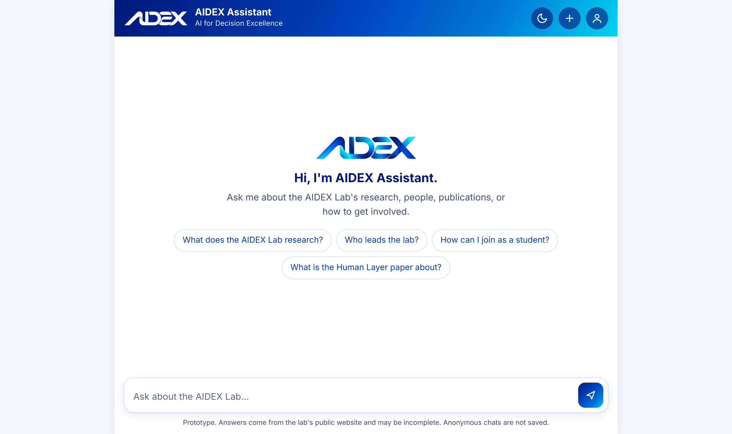
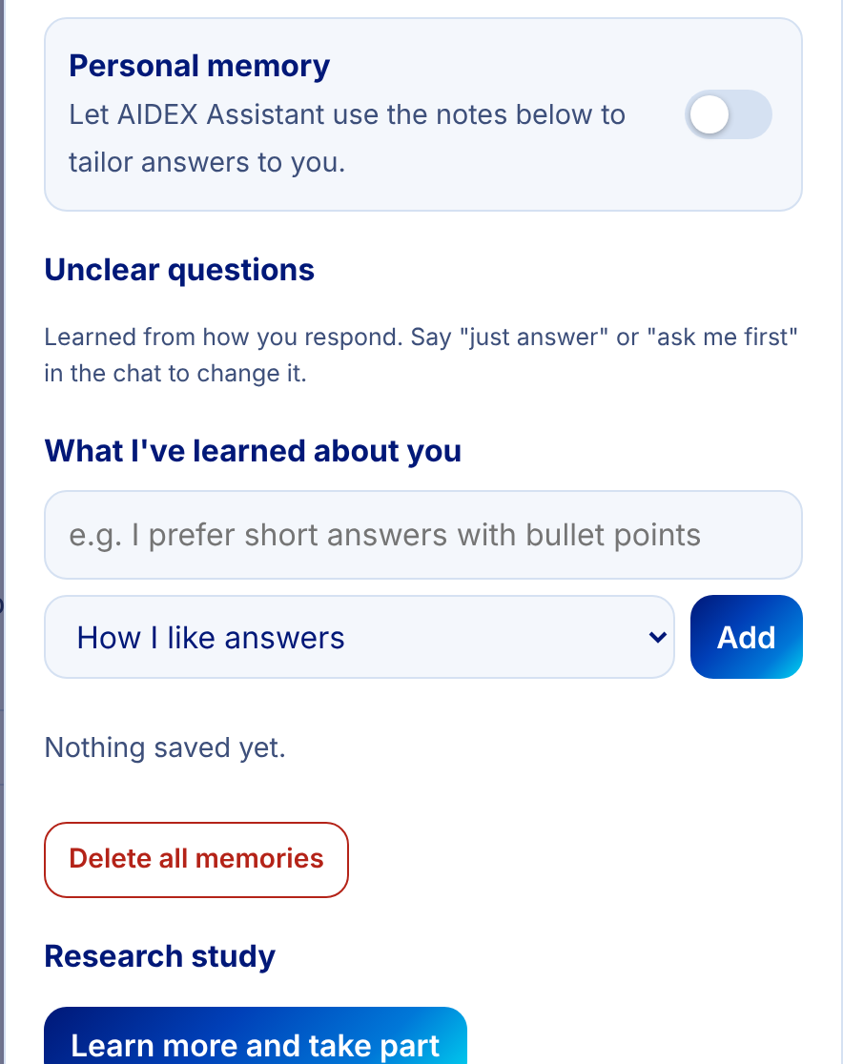
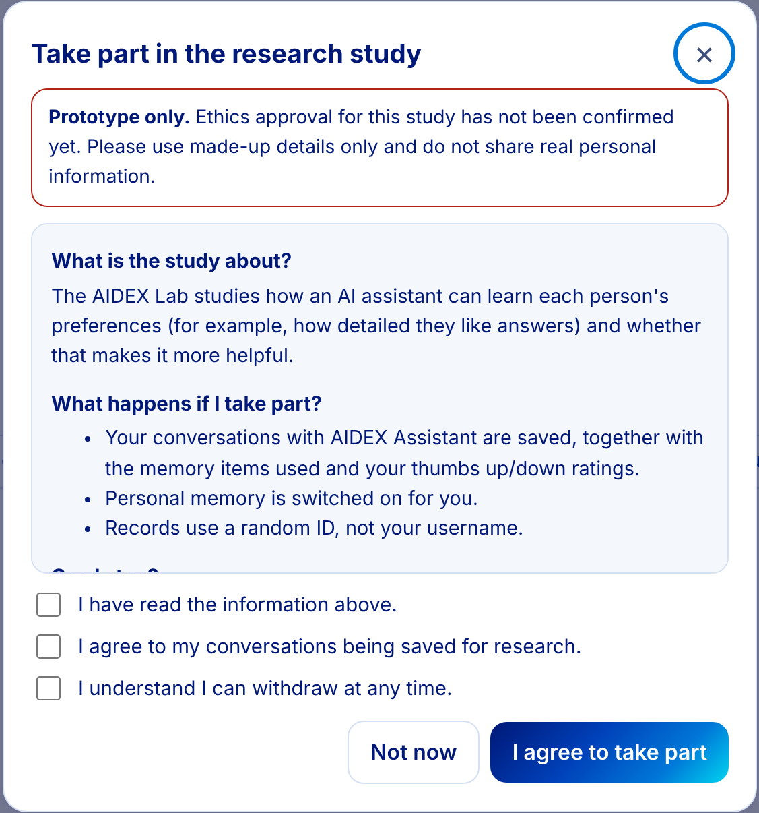




Screens from the working prototype
WHAT HAS BEEN BUILT
Chat with starter questions, light and dark mode, works on phones
Memory the user can see, edit, pause or delete
Research consent, with a clear prototype notice
Opt-in memory
Full control
Informed consent
Download or delete your data
Notes:
And this is what I've actually built. On the left is the chat assistant, with starter questions, light and dark mode in accessible colours, and a layout that works on phones. In the middle is the memory panel, where users can see everything the assistant has learned and edit, pause or delete it. On the right is the research consent screen. Because ethics approval isn't confirmed yet, it clearly says this is a prototype, and nothing is logged for research unless someone agrees.

Slide 13



Testing and evaluation
HOW IT WAS TESTED
Three user types
Anonymous visitors, students with memory, and consenting research participants
Automated tests
Unit and API tests cover retrieval, memory, guardrails, privacy and the dashboard
Synthetic users
A simulation runs the full learning loop over several days, so no real data is needed
Notes:
To test it, I wrote 39 evaluation questions that are scored automatically. Most check whether it knows the lab, and the rest test memory, safety and privacy. They run as three kinds of user: an anonymous visitor, a student with memory switched on, and a consenting research participant. There's also an automated test suite, and a simulation of synthetic users that runs the whole learning loop over several days. One honest point: those are synthetic users. They show the system works end to end, but they're not research findings yet.

Slide 14
Where this goes next
NEXT STEPS
Now
Next
Then
Later
Working prototype
Better answers
Real study
On the lab website
Lab knowledge base
Two-layer memory
Dashboard and tests
Larger local model
Paper abstracts and FAQ
Welcome screen
Ethics approval
Real participants
Compare with and without memory
Guided PhD and partner flows
Deploy for visitors
Notes:
So where does it go from here? Right now it's a working prototype. Next is better answers: a larger local model, plus paper abstracts and an FAQ in the knowledge base. Then the real test: with ethics approval, a study with real participants, comparing the assistant with and without memory to see whether preferences really are reused more than facts. Longer term, it could go live on the lab website with guided paths for prospective PhD students and industry partners.

Slide 15
Thank you
An assistant that answers from verified lab data, learns how each person likes to be helped, and measures whether that matters more than facts
Questions and feedback welcome
Notes:
So, back to where we started. Nobody should have to re-introduce themselves to an AI three times a week. The AIDEX Assistant answers from verified lab data, learns how each person likes to be helped, keeps them in control, and measures whether that actually matters. Thank you for watching, and I'd really appreciate your feedback.

